Slide 1
Introduction to Microsoft Fabric
Module 1

Slide 2
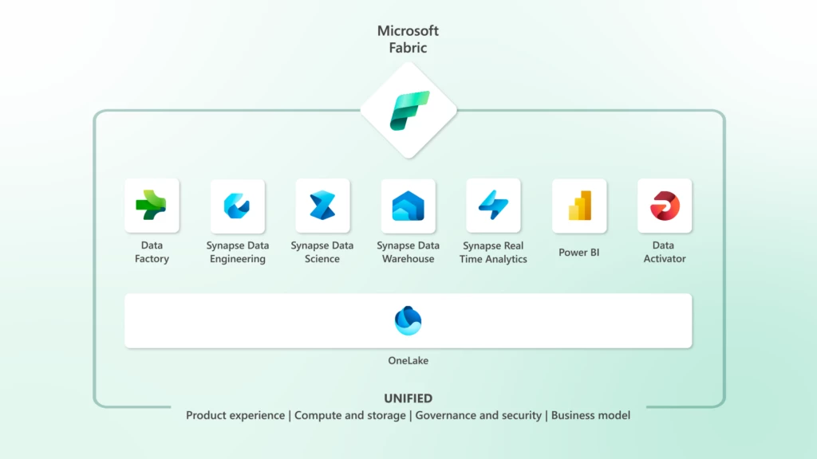
Introducing Microsoft Fabric
Notes:
Every analytics project has multiple subsystems. Every subsystem needs a different array of capabilities, often requiring products from multiple vendors. Integrating these products can be a complex, fragile, and expensive endeavor.
With Fabric, customers can use a single product with a unified experience and architecture that provides all the capabilities required for a developer to extract insights from data and present it to the business user. And by delivering the experience as software as a service (SaaS), everything is automatically integrated and optimized, and users can sign up within seconds and get real business value within minutes.
Fabric empowers every team in the analytics process with the role-specific experiences they need, so data engineers, data warehousing professionals, data scientists, data analysts, and business users feel right at home.
Fabric comes with seven core workloads, that you will learn about in the following slides.

Slide 3
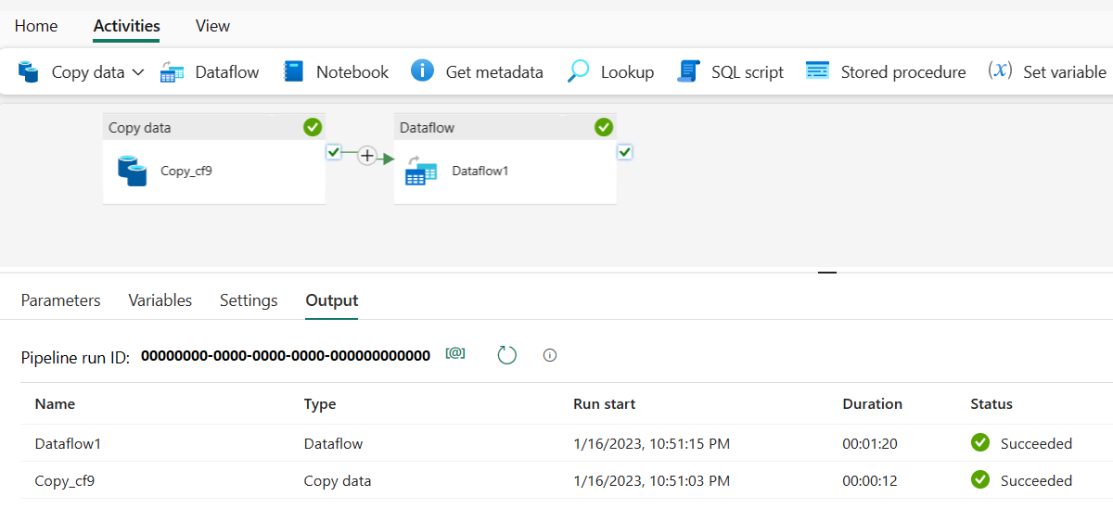
Azure Data Factory
Data Factory is a tools that allows you to move and transform data from disparate systems
Currently Data Factory supports over 150 different connectors to both cloud and on-premises data sources for both data transformation and the ability to orchestrate pipelines
Notes:
In the world of big data, raw, unorganized data is often stored in relational, non-relational, and other storage systems. However, on its own, raw data doesn't have the proper context or meaning to provide meaningful insights to analysts, data scientists, or business decision makers.
Big data requires a service that can orchestrate and operationalize processes to refine these enormous stores of raw data into actionable business insights. Azure Data Factory is a managed cloud service that's built for these complex hybrid extract-transform-load (ETL), extract-load-transform (ELT), and data integration projects.
Azure Data Factory is the platform that solves such data scenarios. It is the cloud-based ETL and data integration service that allows you to create data-driven workflows for orchestrating data movement and transforming data at scale. Using Azure Data Factory, you can create and schedule data-driven workflows (called pipelines) that can ingest data from disparate data stores. You can build complex ETL processes that transform data visually with data flows or by using compute services such as Azure HDInsight Hadoop, Azure Databricks, and Azure SQL Database.

Slide 4
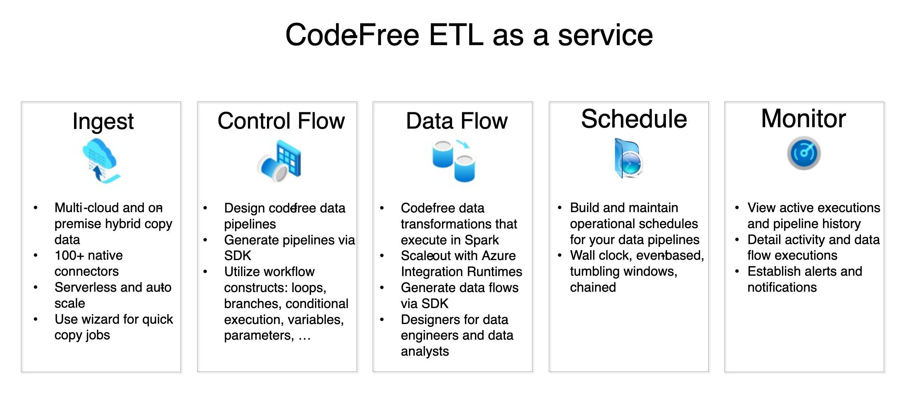
Azure Data Factory

Slide 5
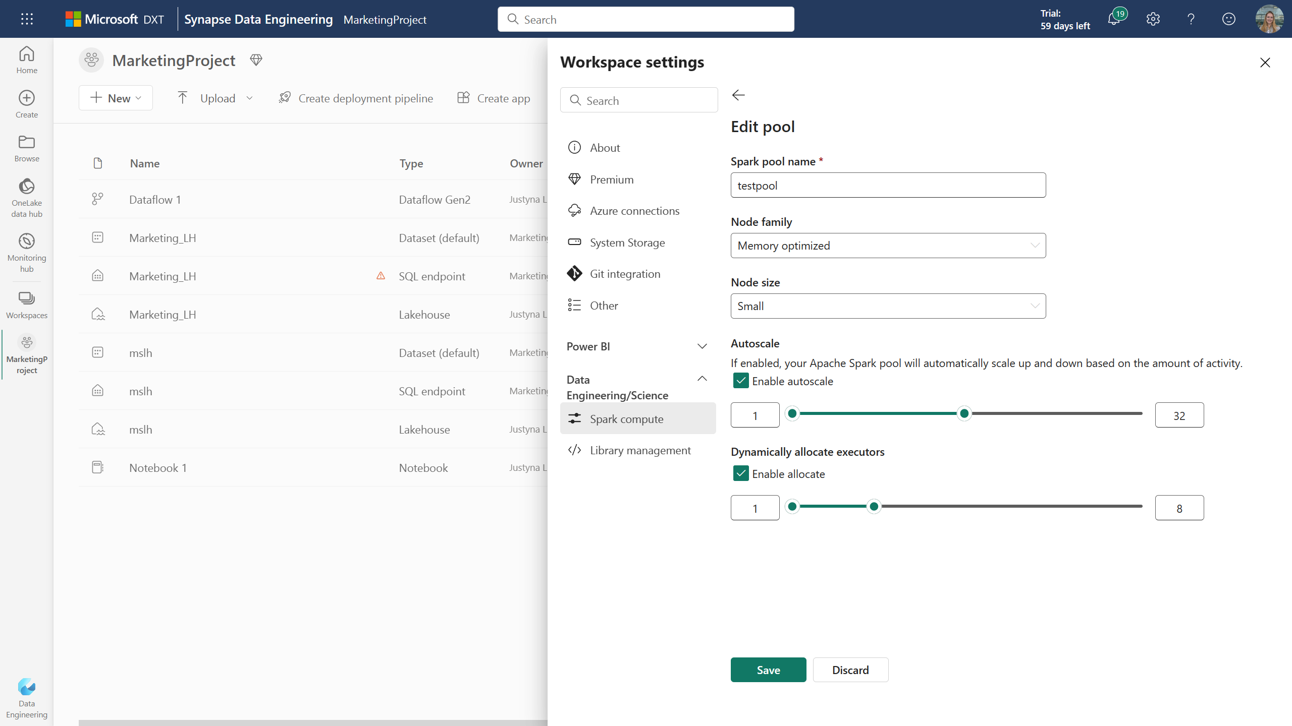
Synapse Data Engineering
Allows Data Engineers to have great Spark experiences
Instant-on Spark pools for data engineering workloads
Allows easy collaboration between teams
Synapse Data Engineering allows uses a Data Lakehouse model to ease ingestion, transforming and sharing of the org’s data
Notes:
With Synapse Data Engineering, we aspire to streamline the process of working with your organizational data. Instead of wasting cycles on the ‘integration tax’ of wiring together a collection of products, worrying about spinning up and managing infrastructure and stitching together disparate data sources, we want data engineers to focus on the jobs to be done.
The lakehouse also streamlines the process of collaborating on top of the same data. Since all the data in Microsoft Fabric is automatically stored in the Delta format, different data professionals can easily work together. The lakehouse comes with a SQL endpoint that provides data warehousing capabilities, including the ability to run T-SQL queries, create views and define functions. Every lakehouse also comes with a semantic dataset, enabling BI users to build reports directly on top of lakehouse data. Power BI can connect to the lakehouse data using ‘Direct Lake’ mode meaning it can read the data in the lake, with no data movement and with great performance.
In Microsoft Fabric, we strive to provide users with great, out of the box performance, with no tuning required, and Spark is no exception. There are a variety of optimizations built into the runtime to ensure data engineers always have a performant experience. These include Spark query optimizations like partition caching, but also Delta optimizations such as ‘V-order’. All Microsoft Fabric engines automatically write Delta with V-order, meaning data is automatically optimized for BI reporting, resulting in great query performance when using Power BI.

Slide 6
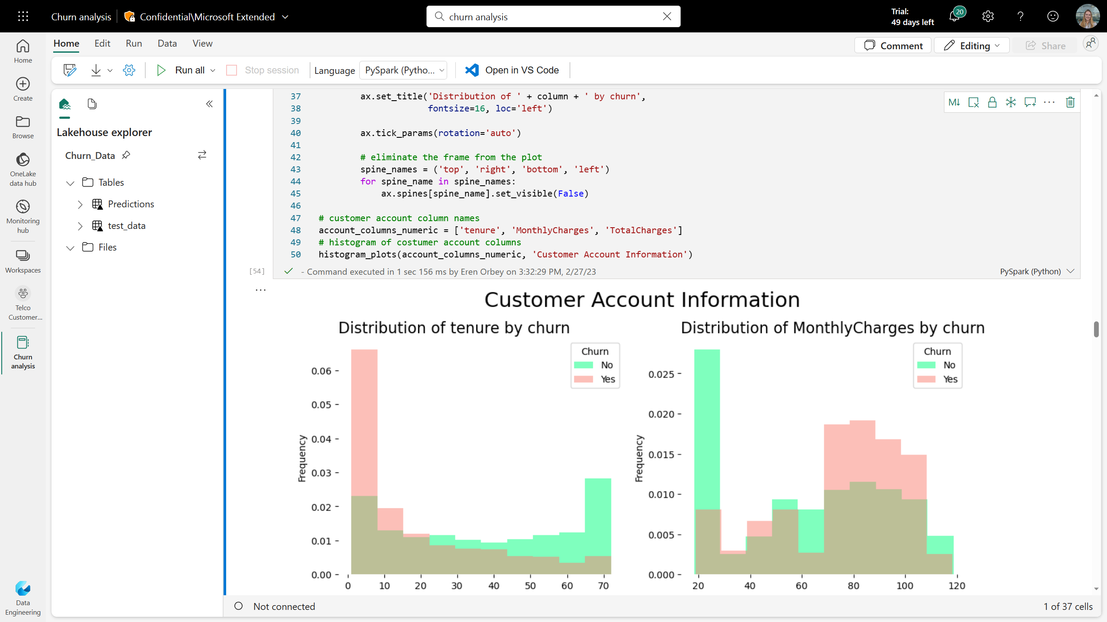
Developer Experience
The primary experience in Fabric Synapse Data Engineering is the notebook
Fabric notebooks have native lakehouse integration and allow easy collaboration between engineering teams
Engineers can install open-souce libraries (R and Python) into their notebooks
Notes:
The goal of Fabric is for every data engineer to have a delightful authoring experience, irrespective of their tooling of choice. The primary authoring canvas offered in Synapse Data Engineering is the notebook. The notebook provides developers with native lakehouse integration, users can easily collaborate thanks to built-in co-authoring, whilst the notebook auto saves, just like in Microsoft Office. Notebooks can be scheduled or added to pipelines for more complex workflows. Data engineers who want to make use of ad hoc libraries during their session, can install popular Python and R libraries in-line leveraging commands like pip install. Notebooks can also reference each other for more modularized ways of working.

Slide 7
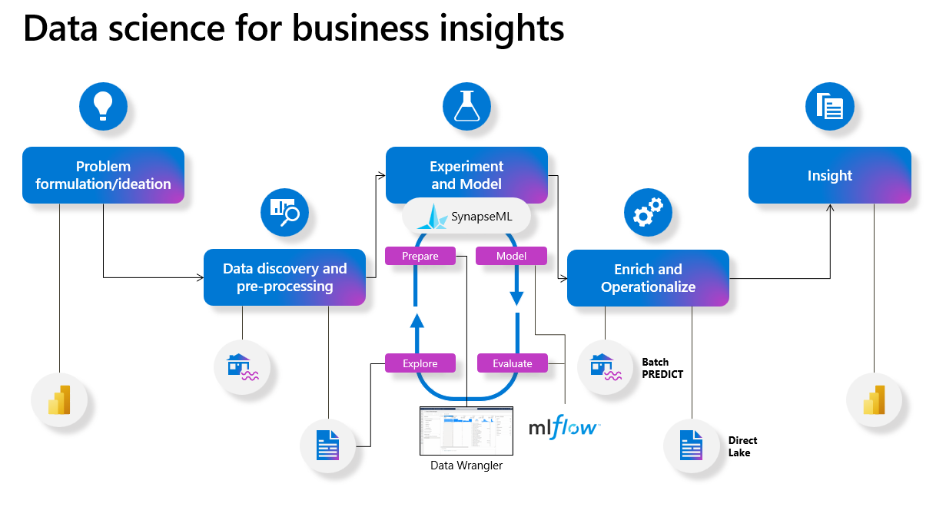
Synapse Data Science
Notes:
Data science is a powerful tool for unlocking the value of data in any organization’s analytics workflow. Through the use of data science, organizations can make more informed decisions and gain predictive insights that would otherwise be unattainable.
Synapse Data Science in Microsoft Fabric allows data science practitioners to work seamlessly on top of the same secured and governed data that has been prepared by data engineering teams. This eliminates the need to copy data and figure out ways to give your data science teams secure access to data. In Microsoft Fabric, the open Delta Lake support allows data science users to version datasets to create reproducible machine learning code. Additionally, data science users have access to a wide range of easy-to-use getting started experiences, low-code tools and code authoring experiences with Notebooks and Visual Studio Code. Synapse Data Science in Microsoft Fabric also provides a rich set of built-in ML tools. For example, MLFlow model and experiment tracking, powered by Azure machine learning, is built in. The SynapseML Spark library provides scalable ML tools and users can serve predictions swiftly to Power BI with the new PBI Direct Lake capability. Finally, streamlined collaboration across different analytics roles makes hand-offs seamless and teams more productive.

Slide 8
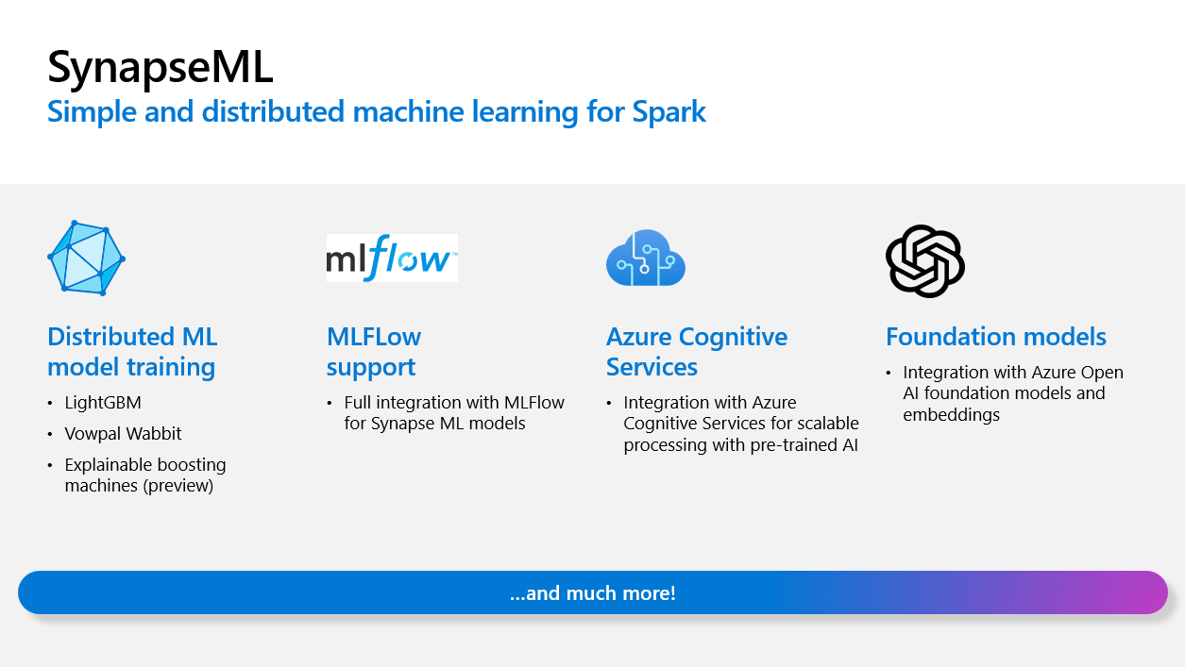
Synapse Data Science Components
Data prep and code generation with Data Wrangler
ML models and experiments as first-class citizens with MLFlow
SynapseML, a comprehensive machine learning library for Spark
Enrich data in your Lakehouse with scalable PREDICT
Notes:
Now that you hopefully have a better understanding of how Microsoft Fabric helps to better integrate data science with analytics and BI, let’s take a closer look at some of the new features and experiences we are introducing.
Data prep and code generation with Data Wrangler
Data Wrangler, a powerful, intuitive tool for data wrangling and preparation. Data Wrangler makes data cleansing and preparation easier than ever before, while still allowing users to take advantage of the power of coding and reproducibility of Python. The dynamic data display, built-in statistics and chart-rendering capabilities along with the ability to get started with Pandas data in just a few clicks, make this tool easily accessible to a range of experience levels, from novice developers to seasoned professionals. Future updates will include support for Spark and a natural language processing “to code” functionality via Azure OpenAI.
ML models and experiments as first-class citizens with MLFlow
We are also making machine learning models and experiments first-class citizens in Fabric. Built-in support for ML models and experiments allows users to manage models and track experiment runs using standard MLFLow APIs. Comparison experiences make it easy to compare different experiment runs and auto logging helps capture key metrics automatically as users author code to train models. The Microsoft Fabric MLFlow tracking store is powered by Azure Machine Learning, which opens the possibility of valuable integrated experiences in the future.
SynapseML, a comprehensive machine learning library for Spark
Additionally, we bring you the Synapse ML Library, the richest machine learning library for Spark, owned and maintained by Microsoft. With the goal to simplify distributed and scalable machine learning, this library provides access to many different ML tools and easy to use APIs for applying ML and enriching data at scale. Core capabilities include distributed ML with performant and popular algorithms like LightGBM as well as full MlFlow support for SynapseML models. Spark operators help users to work with pre-trained AI models from Azure Cognitive Services, including the new Azure Open AI features, for applying foundation model powered transformations directly on data with Spark.
Enrich data in your Lakehouse with scalable PREDICT
We facilitate the operationalization of ML models with the scalable PREDICT function for distributed batch scoring on Spark, allowing users to process predictions without moving any data. Users can write the enriched data to the Lakehouse and serve it seamlessly to BI reports with the powerful Power BI Direct Lake capability. Additionally, we introduce an easy-to-use guided experience that helps users quickly and easily generate code to apply their ML models.

Slide 9
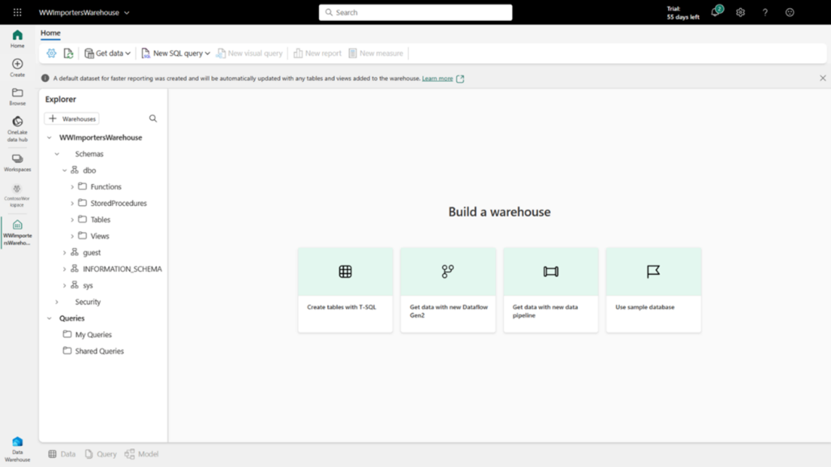
Synapse Data Warehousing
Fully managed data warehouse offering
Separate storage and compute resources
Open data support for delta and parquet
Auto-scaling
Self-optimizing for caching and tiered workloads
Full Fabric integration with T-SQL
Notes:
We are thrilled to announce the preview of Synapse Data Warehouse in Microsoft Fabric! Synapse Data Warehouse is the next generation of data warehousing in Microsoft Fabric that is the first transactional data warehouse to natively support an open data format enabling IT teams, data engineers and business users to collaborate seamlessly and extract actionable insights from their data, all without compromising enterprise security or governance. Just like the previous data warehouse generation, SQL provides multi-table ACID transactional guarantees. It is built on the well-established SQL Server Query Optimizer and Distributed Query Processing engine but is bolstered with the key improvements below that add significant new value to enterprises –
Fully managed: this new data warehouse is a fully managed SaaS solution and effortlessly extends modern data architectures to both professional developers who love to write code and citizen enthusiasts with no coding skills. What previously took enterprises months to accomplish can now be done in minutes efficiently.
No provisioning and managing of resources: instead of provisioning dedicated clusters, it is based on a fully serverless compute infrastructure where resources are provisioned in milliseconds as jobs requests come in. Enterprises benefit from resource efficiencies and only pay for what they use.
Separation of storage and compute: compute nodes used are independent of storage enabling enterprises to scale and pay for either one separately.
Open data standards: data is not locked-in the proprietary SQL Server format but is stored in the open data standard of Delta-Parquet in the Microsoft OneLake providing interoperability not only with all workloads in Fabric but also the Spark ecosystem without requiring any data movement.
Cross-querying: as a result of the open data standard support, data in the lake whether processed by a Fabric workload or any other compute engine can be queried and cross-joined without making any copies of the data.
Auto-scaling: it automatically scales resources instantly as query and usage requirements increase and down-scales when there is no more need for these resources, all without any user intervention.
Self-optimizing: it automatically detects and isolates workloads to deliver predictable performance. The best performance is based on caching which is automatic and multi-tiered based on activity. Query plans generated are optimal. There is no need to hire highly skilled engineers to manage workload groups or tune the data warehouse.
Fully integrated: it is fully integrated with all Fabric workloads right out of the box for any developer. Users can continue to benefit from the rich capabilities of the SQL engine using the T-SQL language or a simple user interface. All this with the continued benefits of the SQL ecosystem.

Slide 10
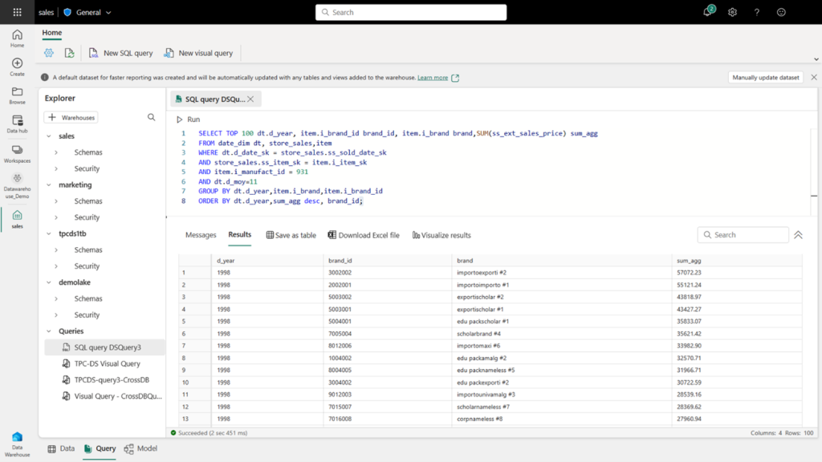
Fabric Data Warehouse Experience
Easily ingest and prep data
Analyze data visually or by writing code
Virtual warehouses for cross-joining warehouses and lakehouses
Add business semantics to data and build Power BI reports that serve insights
Notes:
Simple and intuitive Warehouse experience
Fabric has a dedicated home page for data warehouse, where a new Warehouse can be created with just a name and sensitivity label. There’s no provisioning or setup required. The user interface is a familiar relational database experience. The Warehouse Explorer exposes schemas, tables, stored procedures, and all other database objects. Anyone new to warehousing can start with a Warehouse sample!
Easily ingest and prep data
Data can be loaded into the Warehouse writing T-SQL queries using the COPY command. It can also be ingested using a Data Factory Pipeline which is available now or Dataflow Gen2 which will be available soon, from right within the Warehouse Editor. Pipelines offer connectivity to several data sources, ability to sub-select tables and preview data. Tables are automatically created, and column data types are automatically mapped from source type to Parquet. Data ingested into the Warehouse is stored in OneLake. Table transactions are guaranteed by the SQL compute engine and Delta logs are published periodically. Delta-Parquet in OneLake can be viewed using OneLake Explorer and accessed effortlessly using Notebooks.
Virtual warehouses for cross-joining warehouses and lakehouses
Traditionally, when users wanted to merge data from both the data warehouse and the lake, they were faced with a cumbersome process of creating pipelines, transferring data, and duplicating their data. In Microsoft Fabric, users can create virtual warehouses containing data from any source in Fabric whether a Warehouse or Lakehouse and across any storage or any cloud. As long as the data is in Delta tables, a shortcut can be created to it and queried or cross-joined using T-SQL three-part-naming conventions or the Visual Query Editor.
Add business semantics to data and build Power BI reports that serve insights
Synapse Data Warehouse is fully integrated with Power BI in Microsoft Fabric. A Power BI dataset is automatically generated and kept in sync with the data in the Warehouse. Users do not have to worry about Power BI modes and make trade-offs based on their data volumes increasing or needing to meet performance or security requirements. The experiences to create relationships between tables, add Power BI semantics known as measures is all within the Warehouse Editor.

Slide 11
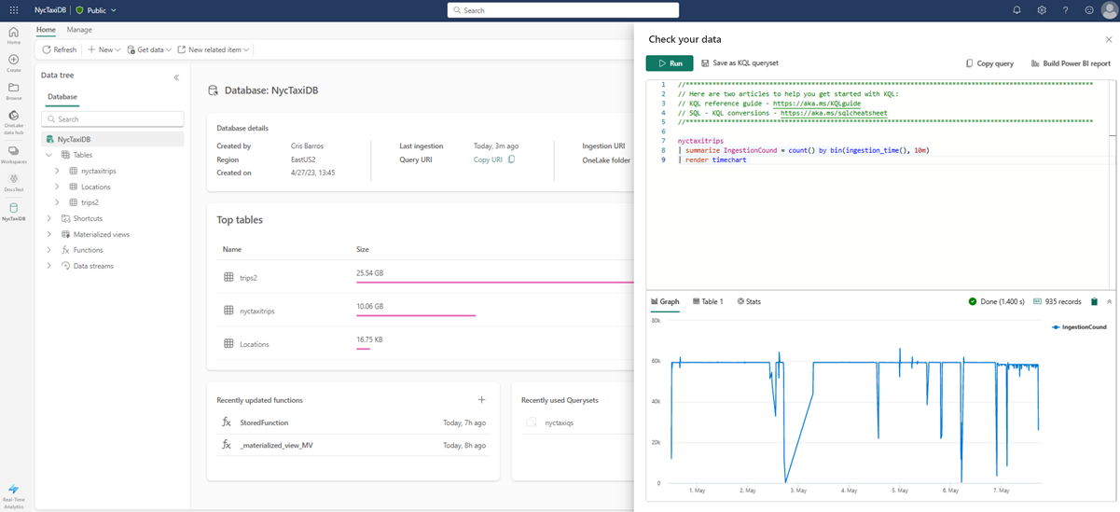
Fabric Real-Time Analytics
Real-Time Analytics is a fully managed big data analytics platform optimized for streaming, and time-series data
Easily ingest or load data from any source, in any data format
Integrate seamlessly with other experiences and items in Microsoft Fabric.
Notes:
Real-Time Analytics is a fully managed big data analytics platform optimized for streaming, time-series data. It contains a dedicated query language and engine with exceptional performance for searching structured, semi-structured, and unstructured data with high performance. Real-Time Analytics is fully integrated with the entire suite of Fabric products, for both data loading and advanced visualization scenarios.
With Real-Time Analytics in Microsoft Fabric, we enable organizations to focus and scale up their analytics solution while democratizing data for the needs of both the citizen data scientist all the way to the advanced data engineer. Real-time analytics have become essential in many scenarios in the enterprise world, such as cybersecurity, asset tracking and management, predictive maintenance, supply chain optimization, customer experience, energy management, inventory management, quality control, environmental monitoring, fleet management, and health and safety.
How? Real-Time Analytics reduces complexity and simplifies data integration. Quick access to data insights is achieved through automatic data streaming, automatic indexing and data partitioning of any data source or format, and by using the on-demand query generation and visualizations. This user process is simplified while preserving powerful analytical capabilities. Real-Time Analytics lets you focus on your analytics solutions by scaling up seamlessly with the service as your data and query needs grow.
Real-Time Analytics is a fully managed big data analytics platform optimized for streaming, and time-series data. It utilizes a query language and engine with exceptional performance for searching structured, semi-structured, and unstructured data. Real-Time Analytics is fully integrated with the entire suite of Fabric products, for both data loading, data transformation, and advanced visualization scenarios.

Slide 12
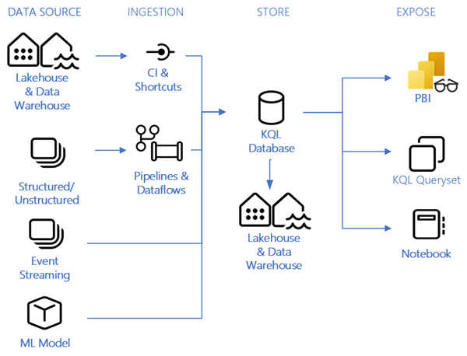
Working with Real-Time Analytics
Eventstream for capturing, transforming, and routing real-time events to various destinations with a no-code experience
A KQL database for data storage and management
A KQL queryset to run queries, view, and customize query results on data
Notes:
The main items available in Real-Time Analytics include:
Eventstream for capturing, transforming, and routing real-time events to various destinations with a no-code experience.
A KQL database for data storage and management. Data loaded into a KQL database can be accessed in OneLake and is exposed to other Fabric experiences.
A KQL queryset to run queries, view, and customize query results on data. The KQL queryset allows you to save queries for future use, export and share queries with others, and includes the option to generate a Power BI report.
An example of how you can use Real-Time analytics in a sales example is shown below:
As a business analyst working for a global retail chain, you're responsible for analyzing the incoming data and communicating your insights to key stakeholders in your business. You can collect and store data from a variety of different sources, such as manufacturers, shippers, suppliers, and in a variety of formats, such as structured, semi-structured, and unstructured data. All this actionable data is captured in a KQL database, providing a scalable data solution for your growing data that can hold billions of records that can be retained for years on end for you to query and compare with the streaming data. Not only can you use a KQL queryset to perform time series analysis, but you can also create Power BI reports visualizing geospatial analytics of land and maritime routes, quickly detect anomalies, and collaborate with project managers on dashboards to make better business decisions.

Slide 13
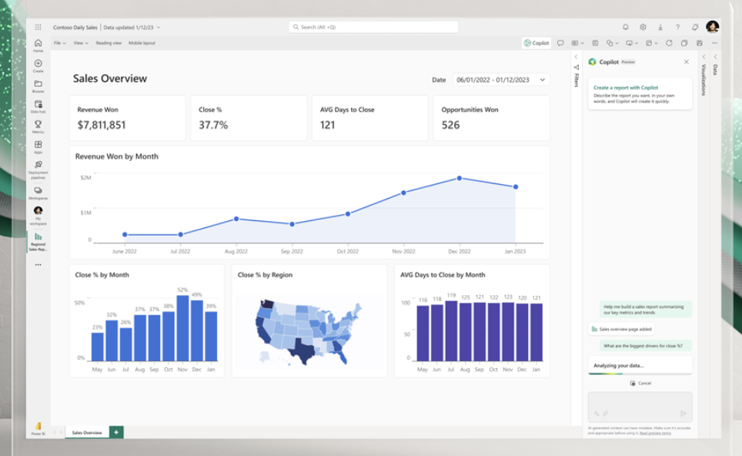
Power BI in Fabric
The Power BI experience in Fabric is completely integrated with the Fabric data services
Power BI users will feel comfortable working with Fabric
CoPilot in Power BI allows users to leverage AI to create and build reports in seconds.
Notes:
With the launch of Fabric, Power BI Premium customers can simply turn on the Fabric tenant setting in the admin portal. With Fabric’s unified capacity model, Power BI Premium capacity can be utilized by any of the new workloads. Read this documentation for more information on Fabric’s single capacity model. Power BI Pro customers can access this functionality through capacity trials.
With Copilot in Power BI, we are infusing the power of large language models into Power BI at every layer to help users get more done and create more value from their data. Using Copilot, you can simply describe the visuals and insights you’re looking for, and Copilot will do the rest. Users can create and tailor reports in seconds, generate and edit DAX calculations, create narrative summaries, and ask questions about their data, all in conversational language. With the ability to easily tailor the tone, scope, and style of narratives and add them seamlessly within reports, Power BI can also deliver data insights even more impactfully through easy-to-understand text summaries.

Slide 14
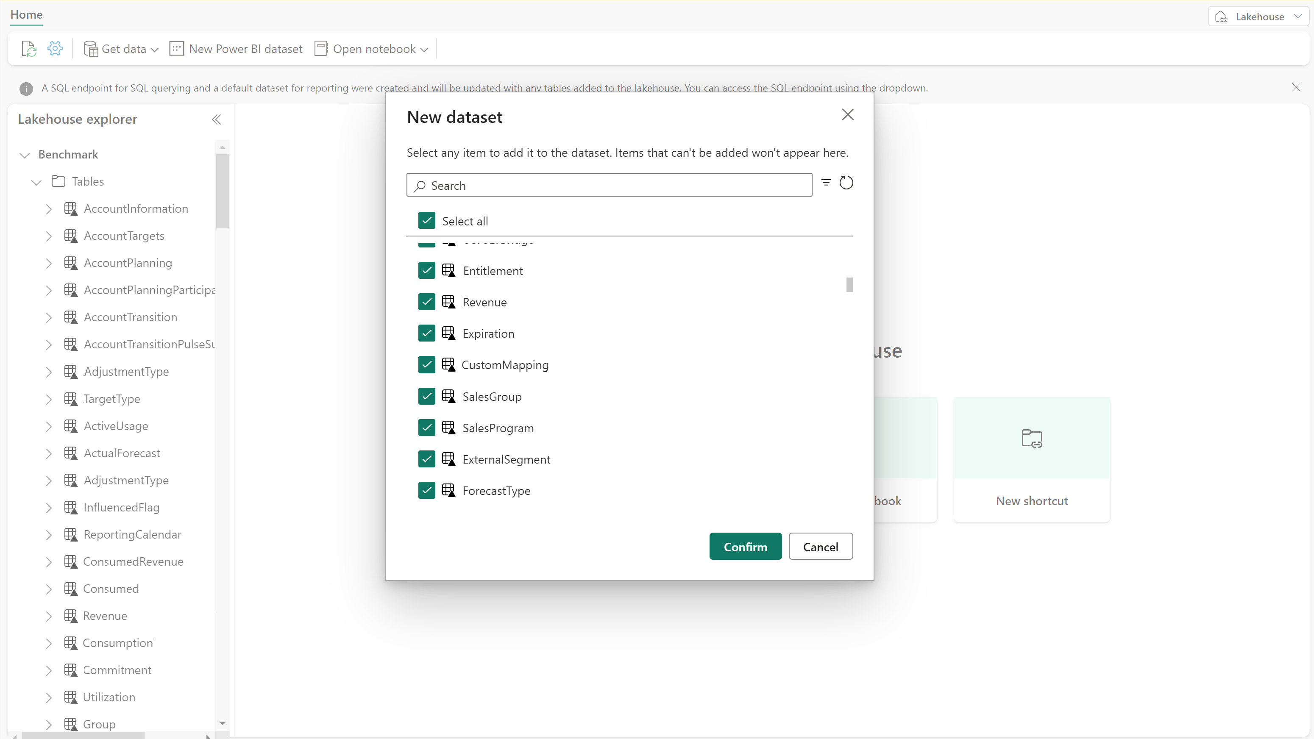
Power BI and Direct Lake
Power BI now has (preview) support for Direct Lake mode for datasets
Direct Lake mode allows for better performance using OneLake with no data movement
Power BI datasets will have performance like imported data sets with the real-time data of DirectQuery
Notes:
Power BI is standardizing on open data formats by adopting Delta Lake and Parquet as its native storage format to help you avoid vendor lock-in and reduce data duplication and management. Direct Lake mode unlocks incredible performance directly against OneLake, with no data movement. Combining this with the ability for the other analytical engines to read and write data directly in the lake, Fabric will reshape how business users consume big data. Power BI datasets in Direct Lake mode enjoy query performance on a par with import mode, with the real-time nature of DirectQuery. And the data never leaves the lake, so there is no need to manage refreshes.
We are thrilled to announce the preview of Direct Lake mode for Power BI datasets on Lakehouses. We plan to launch the preview for Direct Lake mode datasets on Data Warehouses soon. For now, Direct Lake mode datasets for Warehouse is in private preview, but it does take effect if you use the SQL Endpoint for Lakehouse.

Slide 15
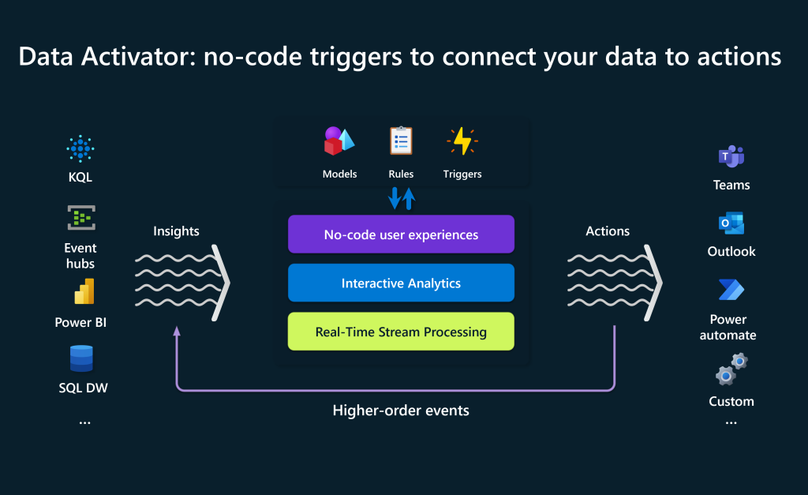
Data Activator (Preview)
Data Activator is a no-code experience to trigger actions based on patterns in your data
To get started you define a connection
You then define actionable data conditions (like a value being exceeded)
Define an action—this can be an email or a Teams alert, or a Power Automate flow
Notes:
Data Activator can act on any type of data in Microsoft Fabric, from relatively slow-moving data in warehouses, to real-time streaming data in Azure Event Hubs. Here are a few examples of how you might put Data Activator to use in your organization:
Sales: alert a sales manager if a particular customer is in arrears with their payments
Inventory: check whether inventory levels for a particular product are sufficient, and notify an operations manager if not.
IT Operations: automatically monitor data quality metrics and kick off remedial processes if those metrics are below target.
IoT: automatically create an engineering support ticket if a refrigerator temperature is too high.
Data Activator drives actions through a 3-step process:
Connect to your data: Data Activator can connect to a wide range of data sources in Microsoft Fabric, from Power BI datasets, Eventstreams, and more. Once Data Activator is connected to your data, it continually monitors it for actionable patterns.
Detect actionable conditions: Data Activator gives you a single place to define actionable patterns in your data. These can range from simple thresholds (such as a value being exceeded) to more complex patterns over time (such a value trending down).
Trigger actions: When Data Activator detects an actionable pattern, it triggers an action. That action can be an email or a Teams alert to the relevant person in your organization. It can also be triggering an automatic process, via a Power Automate flow or an action in one of your organization’s line-of-business apps.

Slide 16
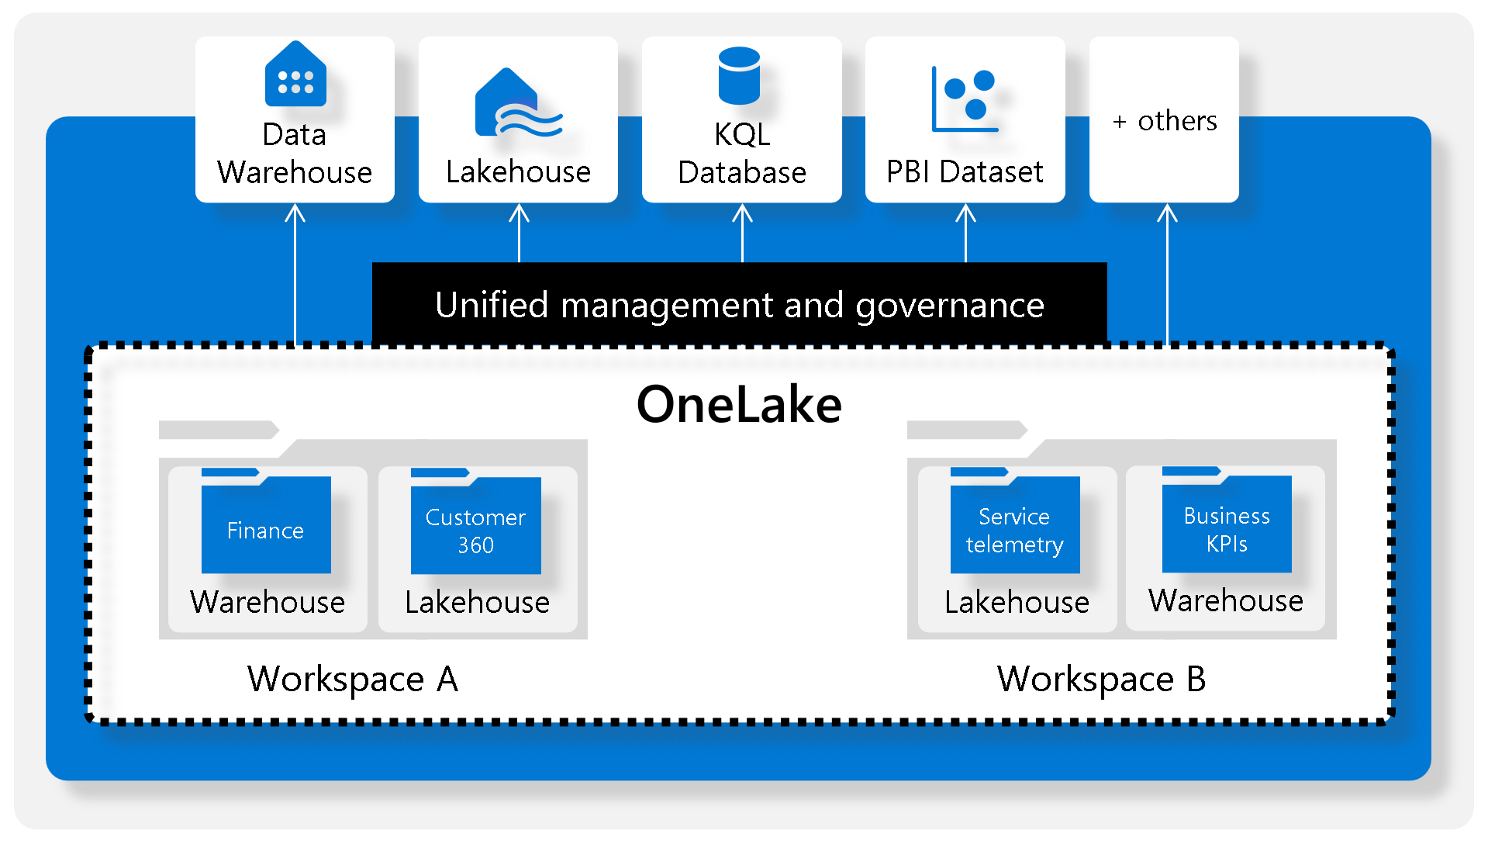
OneLake—The OneDrive for data
OneLake is built on top of ADLS Gen 2 storage
You can connect to OneLake using OneLake file explorer in Windows
OneLake aims to reduce data duplication and data silos in your organization
You can share data across business domains without data movement
Notes:
Today’s data lakes can be messy and complicated, making it hard for customers to create, integrate, manage, and operate data lakes. And once they are operational, multiple data products using different proprietary data formats on the same data lake can cause significant data duplicationn and concerns about vendor lock-in.
Fabric comes with a SaaS, multi-cloud data lake called OneLake that is built-in and automatically available to every Fabric tenant. All Fabric workloads are automatically wired into OneLake, just like all Microsoft 365 applications are wired into OneDrive. Data is organized in an intuitive data hub, and automatically indexed for discovery, sharing, governance, and compliance.
OneLake is the OneDrive for data. Just like OneDrive, OneLake data can be easily explored from Windows using the OneLake file explorer for Windows. Directly in Windows, you can navigate all your workspaces, data items, easily uploading, downloading or modifying files just like you can do in office. The OneLake file explorer simplifies data lakes putting them into the hands of even nontechnical business users.
One copy of data
OneLake aims to give you the most value possible out of a single copy of data without data movement or duplication. You'll no longer need to copy data just to use it with another engine or to break down silos so that data can be analyzed with other data.
Shortcuts let you connect data across business domains without data movement
Shortcuts allow your organization to easily share data between users and applications without having to move and duplicate information unnecessarily. When teams work independently in separate workspaces, shortcuts enable you to combine data across different business groups and domains into a virtual data product to fit a user’s specific needs. A shortcut is a reference to data stored in other file locations. These file locations can be within the same workspace or across different workspaces, within OneLake or external to OneLake in ADLS or S3. No matter the location, the reference makes it appear as though the files and folders are stored locally.

Slide 17
Summary—Fabric Overview
Fabric combines several best-in-class products in an integrated SaaS platform with many value adding enhancements like OneLake and Data Activator
Having a single platform for all data analytics allows you to purchase a single pool of computing for all analytic workloads
The use of existing tools makes the transition from disparate solutions easier for existing users. For example, Power BI users can start building reports on day 1.
Notes:
Customers aspire to drive a data culture where everyone in their organization is making better decisions based on data. To help our customers foster this culture, Fabric deeply integrates with the Microsoft 365 applications people use every day.
Power BI is a core part of Fabric and is already infused across Microsoft 365. Through Power BI’s deep integrations with popular applications such as Excel, Microsoft Teams, PowerPoint, and SharePoint, relevant data from OneLake is easily discoverable and accessible to users right from Microsoft 365—helping customers drive more value from their data
With Fabric, you can turn your Microsoft 365 apps into hubs for uncovering and applying insights. For example, users in Microsoft Excel can directly discover and analyze data in OneLake and generate a Power BI report with a click of a button. In Teams, users can infuse data into their everyday work with embedded channels, chat, and meeting experiences. Business users can bring data into their presentations by embedding live Power BI reports directly in Microsoft PowerPoint. Power BI is also natively integrated with SharePoint, enabling easy sharing and dissemination of insights. And with Microsoft Graph Data Connect (preview), Microsoft 365 data is natively integrated into OneLake so customers can unlock insights on their customer relationships, business processes, security and compliance, and people productivity.
Today’s analytics systems typically combine products from multiple vendors in a single project. This results in computing capacity provisioned in multiple systems like data integration, data engineering, data warehousing, and business intelligence. When one of the systems is idle, its capacity cannot be used by another system causing significant wastage.
Purchasing and managing resources is massively simplified with Fabric. Customers can purchase a single pool of computing that powers all Fabric workloads. With this all-inclusive approach, customers can create solutions that leverage all workloads freely without any friction in their experience or commerce. The universal compute capacities significantly reduce costs, as any unused compute capacity in one workload can be utilized by any of the workloads.

Slide 18

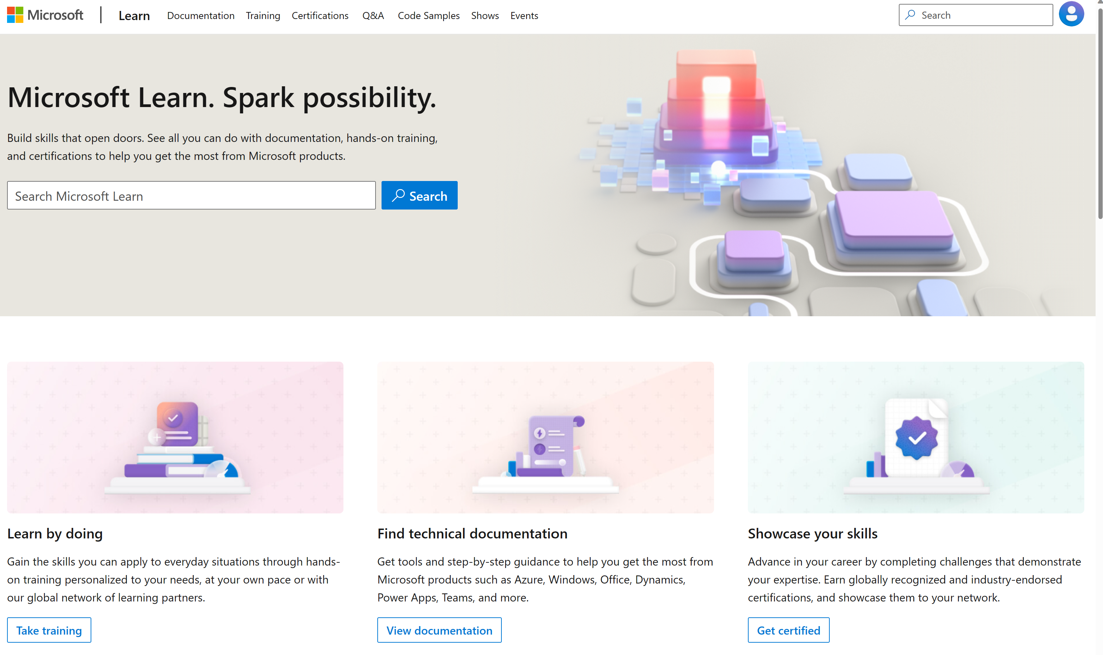
Microsoft Learn Demo
Microsoft Learn: Build skills that open doors in your career

Slide 19
Readiness and Enablement Links
The Microsoft Federal Team is here to help you accelerate customers' digital transformation. Microsoft Federal has tailored to make your organizations skilling journey successful. From the Business Decision Maker to the technical community and end-users, Microsoft provides customers with access to endless skilling resources. Below you will find links to these resources:
Get training tailored to your organization's needs: Find learning paths for specific roles in your organization, plus course recommendations based on technology, skill level, and solution area: Training | Learning Portal (microsoft.com)
Events Calendar - US Partner Community Blog – Microsoft
In addition to the above, the Microsoft Federal Team can address the needs of your non-technical community of your learners through:
Skilling Hours - Readiness and Enablement: Skilling our Federal Customers and Partners (office.com)
Microsoft Learning Portal: A closer look at Azure through training modules and gamified learning
Microsoft Learning Portal
Additional Learning Resources:
Get started with Azure – Introduction | Microsoft Azure
Microsoft Learn (path-based)
Exam-based: Select filters: Azure, D365, M365, Power Platform, and more
Microsoft Virtual Training Days – Virtual Instructor Led
Microsoft Technology Center - Work through your Account Manager
Home - Microsoft Tech Community
Microsoft Reactor | Microsoft Developer – Virtual Instructor Led

